Slide 1
PillMinder
Team Hela:
Pravin Rajput
Ujjwal Verma
Sahithi Kotte
Rohit Nain
Ranjan Pathak
HACKATHON 2021

Slide 2
Problem Statement
During these very busy days, it is hard to keep track of the hourly medicines that elderly and people with special needs consume. There have been many incidents recently how people have suffered because of overdose or health issues because they might have missed to take a pill or two.
We wanted to develop a model that keeps track of these pills and sends alerts or reminders to their care-takers.
HACKATHON 2021
2

Slide 3
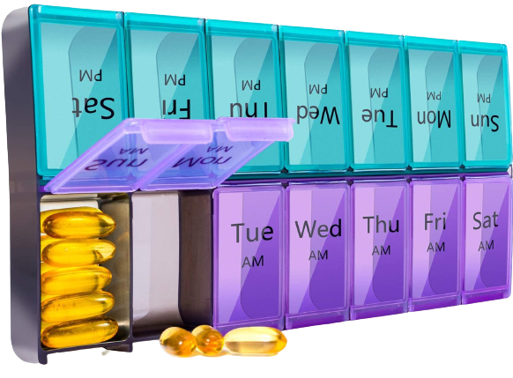
What our App does?
Our PillMinder app always monitors the pillbox which contains the medicines organized for the entire week. This camera constantly monitors the pillbox and talks to the backend server which communicates to the mobile app which can be installed by the caretakers. If there is any missing dose or overdose . It immediately alerts the caretaker, and they can take necessary actions.
3
HACKATHON 2021

Slide 4





The Five Ws
WHO
WHAT
Elders
People who need special care
Children
Patients
This app detects anomalies in the weekly pillbox of a person who requires special care and alerts their caretaker.
If a patient takes an extra pill or forgets to take the pill, PillMinder comes into picture to remind the caretaker about it, who in turn would take necessary actions to overcome the situation.
WHEN
WHY
WHERE
Many cases have been reported especially with elderly people who have had high dosage of medicine and in many cases, people often forget to take their medicine which is harmful in the long run. And most of them who needs to look after such patients may not be able to stay with them the whole day. This App would give them the freedom to move out confidently.
This android application is easily accessible to
anyone who owns a smart phone.
HACKATHON 2021
4

Slide 5

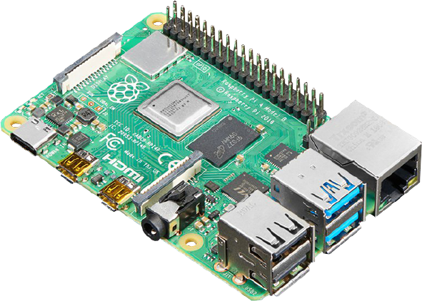

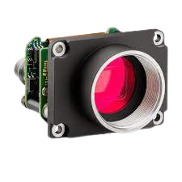

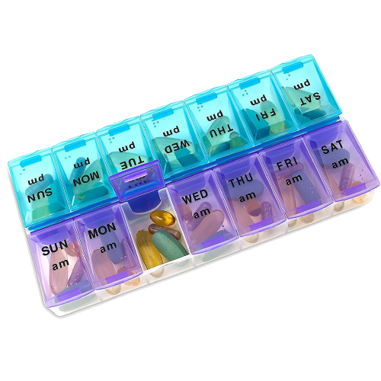


Design Overview
PillMinderCapture
PillMinder
HACKATHON 2021
5

Slide 6
FUTURE SCOPE
More efficient Algorithms can be used to detect and analyze the type and number of pills
This model can be extended to be used in different type of Pillboxes
Further analysis of data can de done to find any patterns that will help us understand patient’s behavior
HACKATHON 2021
6

Slide 7
Thank You
HACKATHON 2021

